Slide 1
Application Alerting
Anomaly detection on traces

Slide 2
Overview
Anomaly detection on traces
Inputs
General principle
Streaming statistics
Data pre-processing
Summary
Integration in ContinuousC

Slide 3
Inputs: trace data
Unit of data: spans
Identification: traceID, spanID, operationName
Process: serviceName, serviceNamespace, serviceInstanceId, ...
Reference: CHILD_OF (trace id, span id)
Timing: startTime, duration
Implementation-specific tags
E.g. Tokio: idle, busy, thread id
Processing full traces:
PIT Query of root spans since last time:
Query: “NOT references : { refType : CHILD_OF } AND startTime : [last, now - x]”
Slight delay to allow all services to write spans
Query traces in chunks fitting one query

Slide 4
Finding anomalies: general principle
Collect stats over sliding windows:
Reference window, e.g. 7x24x1h
Sample window, e.g. 5x1min
Statistics:
Numeric: count, sum, sum of squares, t-digest
Outputs: count, mean, stddev, percentiles
Bool: count, count true
Outputs: count, rate
Compare sample (short-term) to reference (long-term)

Slide 5
Windowed accumulation
Reference Window
...
Trace
Sample Window
Accumulator by key
Span
Start time
Key 1
Accumulator
Processed Span Data
Bin width
Span
Ring buffer
Key 2
Accumulator
Span
Span
Number of bins
Key 3
Accumulator
Span
Position
Rate accumulator
Sample accumulator
Number accumulator
Count
Errors
Duration
Count
Sum
Count True
Busy
Idle
T-Digest
Sum of squares

Slide 6
Windowed statistics extraction
Accumulator by key
Sample Window
Sample accumulator
Number accumulator
merge
Key 1
Accumulator
Errors
Duration
Count
Sum
Key 2
Accumulator
Ring buffer
Busy
Idle
T-Digest
Sum of squares
Key 3
Accumulator
Stats by key
Sample accumulator
Number accumulator
Key 1
Stats
Count
Mean
Errors
Duration
Key 2
Stats
Busy
Idle
Percentiles
Stddev
Key 3
Stats

Slide 7
Operation key
Required: service_namespace, service_name, operation_name
Optional: service_version
When excluded: changes from one version to another can generate alerts
When included: when version is updated, new reference must be built
Optional: service_instance_id
When excluded: data from all instances is compared
When included: reference is built per instance, no comparison between instances
Optional: parent operation or full path to operation
Optional: other tags (implementation-specific)

Slide 8
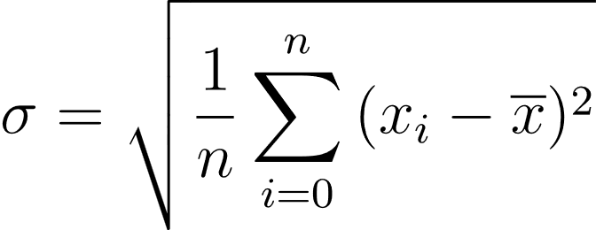
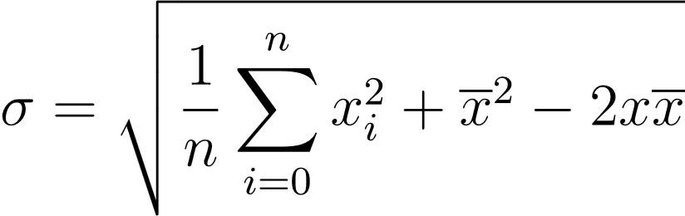
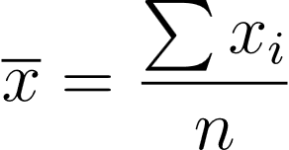
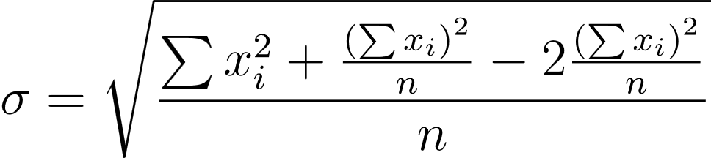
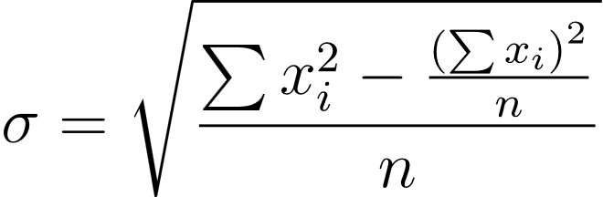
Standard deviation from streaming stats
Definition:
Would require keeping all values in memory
Reworked for streaming data:
Using only count, sum and sum of squares

Slide 9
Self-duration
Duration of span is the total duration, including child spans
Duration anomaly in a span leads to anomaly in all ancestor spans
To avoid this, calculate duration not counting child spans:
Start with duration = span duration, end_time = start_time
For direct children, ordered by start_time:
Duration:
Subtract child duration
Add (end_time – child start_time), clamped between 0 and child duration
End_time:
Set to max of end_time and child end_time
We assume there is no parallel work in the parent span
Self-duration
Parent span
Child 1
Child 2
Child 3

Slide 10
Duration sampling
Confidence interval: given the observed durations in the sample, is there a statistically significant difference in average from the reference (at a certain confidence level)?
When call rate is low, a large increase is required to trigger an alert
When call rate is high, a smaller increase can trigger an alert
duration
Alerting
t
Sample windows
Reference windows

Slide 11
Call and error rates
Call and error rates calculated per sample window
Error: error == true OR exception.message exists
Statistics over these rates are calculated for reference window
Rates in sample window are compared to reference
Alerting
Trace
data
Call rate
Sample windows
(5 minutes)
Error rate
Compare
Reference windows
(1 week)
Reference stats

Slide 12
Tokio: idle and busy times
Measures how long an instrumented future has been busy / idle
Timings include time spent busy / idle in child spans
Timings of concurrently running children (~ same thread id) are summed (thread runs at most one sub-future at a time)
Children run in parallel (spawned ~ different thread id) do not count towards timings
Calculate self busy as busy - sum( child busy for all direct children with the same thread id )

Slide 13
Summary: trace data processing
Config
Trace
Reference Window
Reference Stats
Span
Processed Span Data
Comparison
Alerting
Span
Sample Window
Sample Stats
Span
Span
Span

Slide 14
Integration in ContinuousC
Trace
Span
Jaeger Collector
OpenTelemetry Collector
OpenSearch
Span
Span
Span
Jaeger Processor
Prometheus (Cortex)
Span
Prometheus Schema
Config
Ruler
Alerting

Slide 15
Which stats to write?
Processed statistics:
Mean over 5m, 7d, 30d
Stddev over 5m, 7d, 30d
Bounds of confidence interval over 5m
Raw statistics:
Count
Sum (counter)
Sum of squares (counter)
Percentiles:
Summary (fixed percentiles)
Histogram (fixed bins)

Slide 16
Writing processed statistics
Advantages
Simple alert rule expressions
Less calculation needed for alerting and graphs
Disadvantages
Intervals are fixed
Only pre-configured cardinality (for stddev, summary)

Slide 17
Writing raw statistics
Advantages
Intervals can be chosen freely
Disadvantages
More complex expressions (but could be solved by GUI)
Calculations need to be done (repeated) at query time
Points of attention
Limitations due to limited floating-point precision

Slide 18
Histograms or summaries
Summary (fixed percentiles)
(More) accurate percentiles (depending on algorithm in client)
Available percentiles are fixed
Easier to define generically
Histogram (fixed bins)
Bins need to be pre-defined
No good default exists for all operations
Copy Prometheus native histograms bounds?
Needed to get exact numbers for SLOs

Slide 19
The problem
Prometheus metric values are doubles (64-bit)
Precision can be an issue for counters that grow over 53 bits (2^53 ≈ 10^15.95)
Durations in nanosecond resolution are 10^9 for one second
Sum starts to lose precision after 10^7 calls (e.g. 2.7 hours with 1000 calls/second)
Sum of squares starts to lose precision after one call

Slide 20
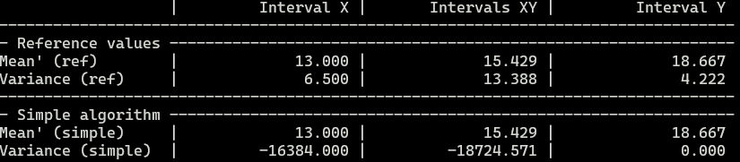
Analysis
Loss of precision in two places:
In the trace processor: when adding small numbers to a large counter
In prometheus: storage and calculations
Effects on calculated results:
Mean: gradual loss of precision with higher resolution longer-running counters, longer requests and higher request rates
Stddev: catastrophic cancellation even for small numbers (eg duration > 10^10 with small stddev)

Slide 21
Solutions
Use shifted sum and sum of squares for stddev calculation
How to estimate useful amount of shift? Mean of first n results?
Use separate counters for every interval and integrate in total
Use higher precision counters internally
Floating-point operations implemented in software are slower
Crate rustc_apfloat provides quadruple precision softfloats
Intel cpus have hardware support for f80 (issue for rust support)
Still loses precision in Prometheus (storage and calculations)
Keep intermediate results in state
Save two time-series (*_high, *_low)
Prometheus expressions become extra complicated
Alternative algorithms (see wikipedia , blog)
Welford’s online algorithm
Youngs and cramer updating algorithm

Slide 22
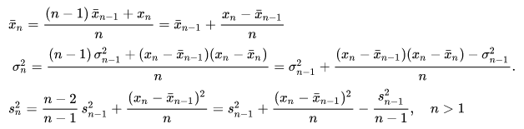
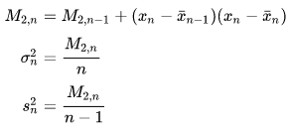
Welford’s algorithm (from Wikipedia)
For every sample value:
For better numerical stability, use intermediate variable M2:

Slide 23
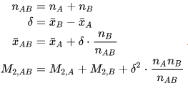



Calculating mean and stddev for sub-intervals
Combining results (Chan et al, from Wikipedia):
Reworked for extracting sub-interval:

Slide 24
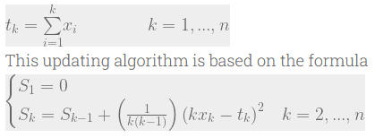


Youngs & Cramer’s algorithm (see blog post)
For every sample value (var = S / n):
Combination of intervals:
Reworked for extracting sub-interval:

Slide 25
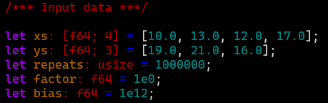
Test case

Slide 26
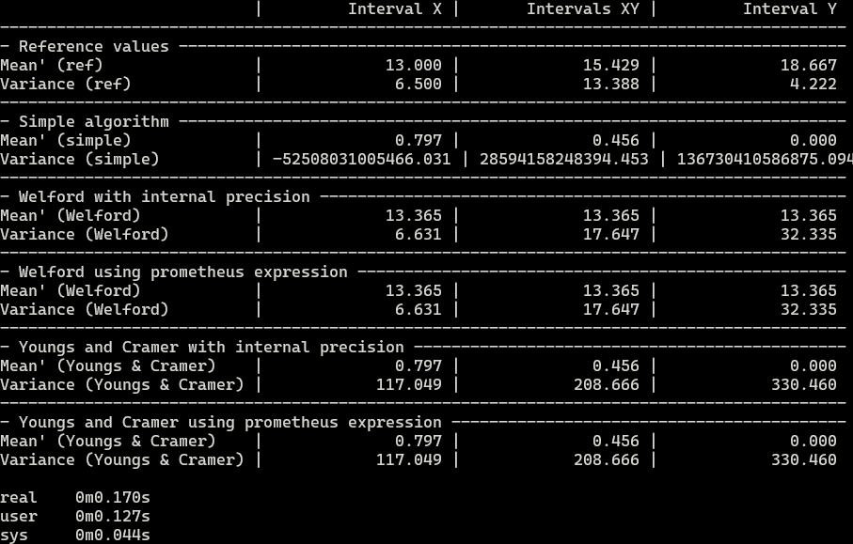
Test with double precision

Slide 27
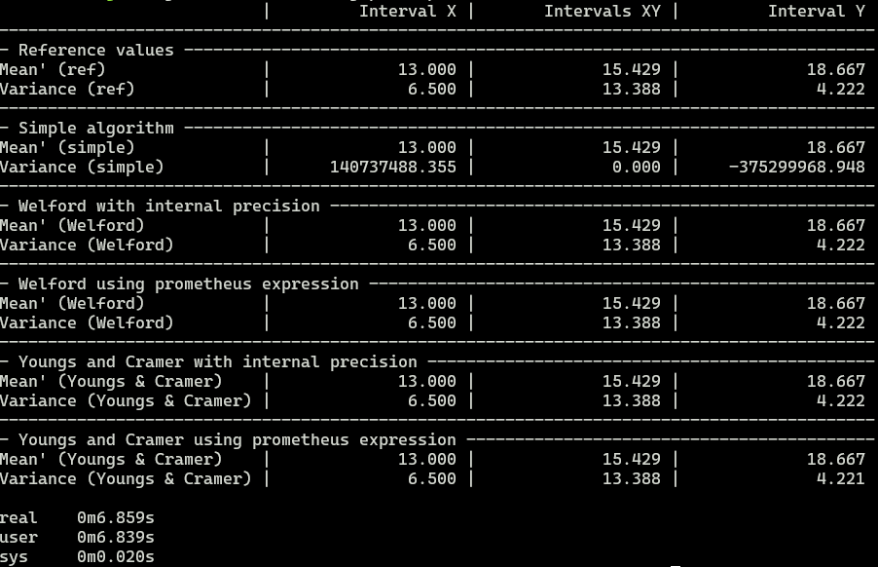
Test with quad precision

Slide 28
Integration in ContinuousC
Trace
Span
Jaeger Collector
OpenTelemetry Collector
OpenSearch
Span
Span
Span
Jaeger Processor
Prometheus (Cortex)
Span
Prometheus Schema
Config
Ruler
Alerting

Slide 29
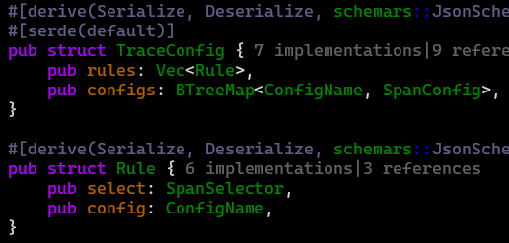
Configuration: rules
Rule-based, selecting on span:
Span selector
Configuration to be applied

Slide 30
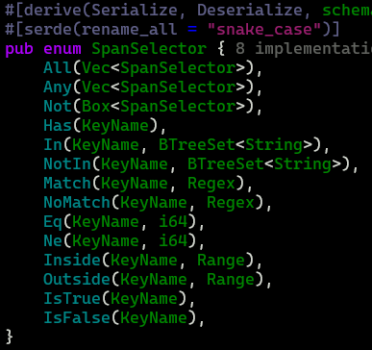
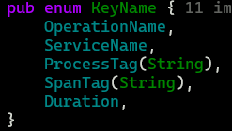
Configuration: selecting spans
Match spans based on:
Service name
Operation name
Process tag
Service namespace
Service instance id
Any other process tag
Span tag
Duration

Slide 31


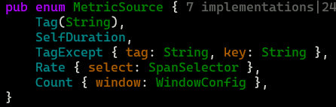
Configuration: metrics
Configurable elements:
Key (cardinality)
Metrics:
Source:
Self-duration
Specific tag
Tag except... (for busy)
Rate (for error_rate)
Count (for call_rate)
Stats to generate

Slide 32




Configuration: stats
Statistics to write for metric:
Mean / stddev
Algorithm: sum/count, welford
Summary
Window params
Percentiles
Histogram
bounds

Slide 33
Default metrics
Default key
Service namespace
Service name
Service instance id
Operation name
Default stats:
Mean / stddev: welford
Summary:
Window: 5 x 1 minute
Percentiles: 0.50, 0.95, 0.99
Histogram: disabled
Default metrics
(Self-)Duration
Busy
Call_rate
Error_rate
Selects:
“error” is true
“exception.message” exists
“http.status_code”
doesn’t match “^2..$”
not in range 200..299

Slide 34
State and config updates
Config defines shape of processor / processor state
To recreate processor on reboot, both state and config are required
On config update, relevant state is preserved, while other state elements are reinitialized
Processor element functions to handle config:
New(Self::Config) -> Self
Update(self, Self::Config) -> Self
Processor element functions to handle state:
Load(Self::State, Self::Config) -> Self
Save(self) -> Self::State

Slide 35
Prometheus expressions
Prometheus schema available on endpoint: /api/jaeger-anomaly-detection/prometheus-schema
Prometheus expressions over welford stats are non-trivial to write
Missing student’s-t inverse cdf function (confidence interval)
Could be done client-side for graphs
Required for alert rule expressions
Jaeger anomaly detection service contains an endpoint to generate prometheus expressions (could be done in wasm)

Slide 36
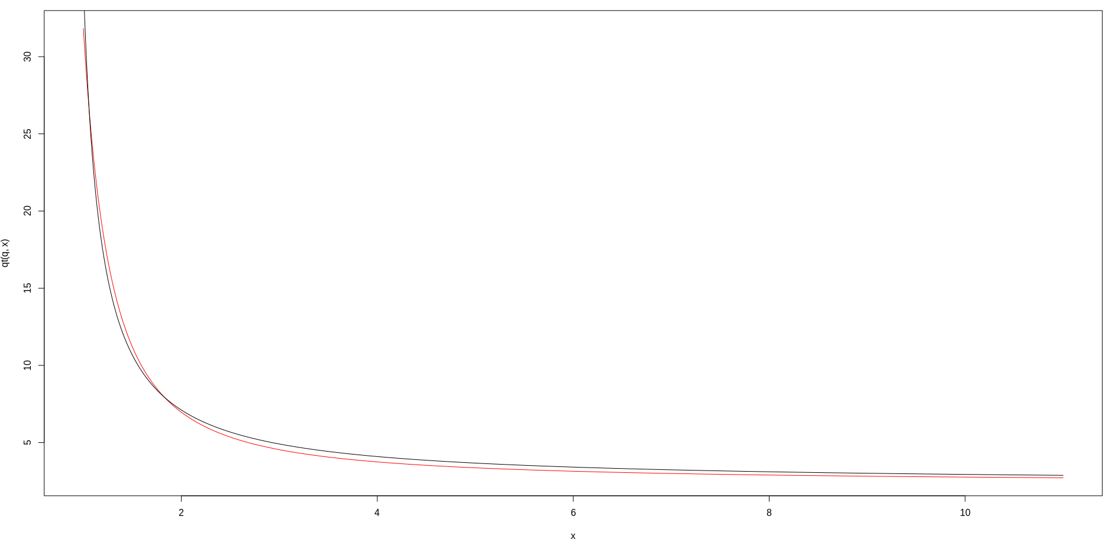

Student’s T inverse cdf approximation
In Prometheus expressions, we need qt(q, df) with fixed q, variable df
Estimate using:
Find s in interval 0..1, minimizing error
Error criterium: max relative difference
Example for q=.99, s=.827140
Black line: approximation
Red line: target

Slide 37
Prometheus expressions
Parameters (welford)
Metric: base name of the metric to query (e.g. duration, error_rate)
Labels: map of labels selectors (e.g. operation_name, service_name)
Duration: interval over which to calculate individual points (e.g. 5m, 15m)
Larger interval gives smoother graphs
Q: certainty level for confidence interval (default = 0.99)
Generated expressions:
Count: number of observations
Mean: sliding mean value
Stddev: sliding standard deviation
Low / High: bounds of confidence interval

Slide 38
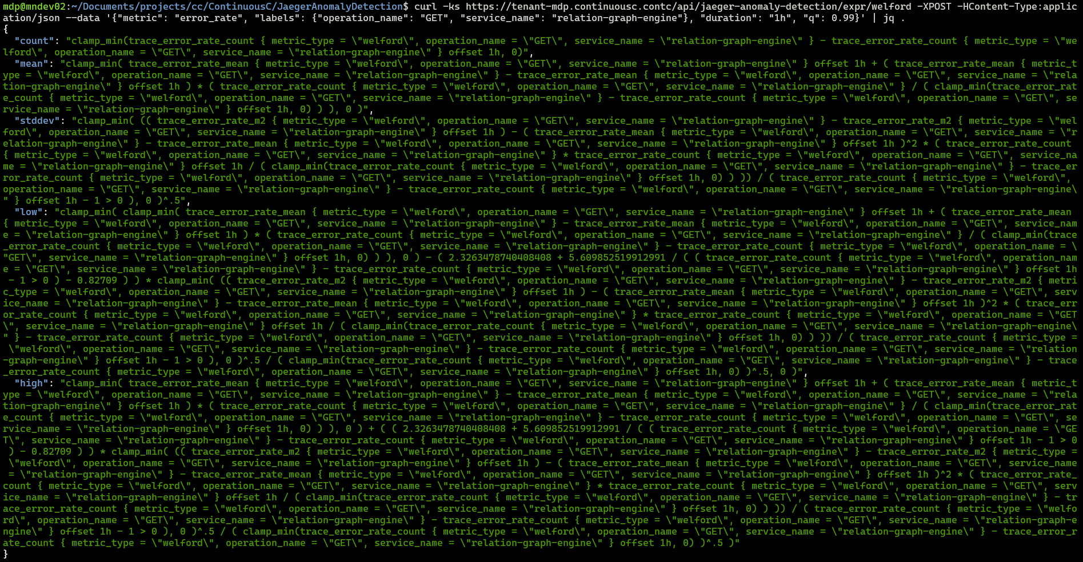
Prometheus expressions: output

Slide 39
Graphs
Graphs to include in GUI:
(Self-)Duration
Async busy time
Error rate
Call rate
See example graph generator in service
Requires specific metrics to be configured
Initial version: expose limited trace processor config
Allow configuring summary quantiles
Allow configuring histograms
Allow configuring extra metrics
In the future:
Always apply “default” rule + extra rules?
Disallow overriding essential elements (key + metrics)?

Slide 40
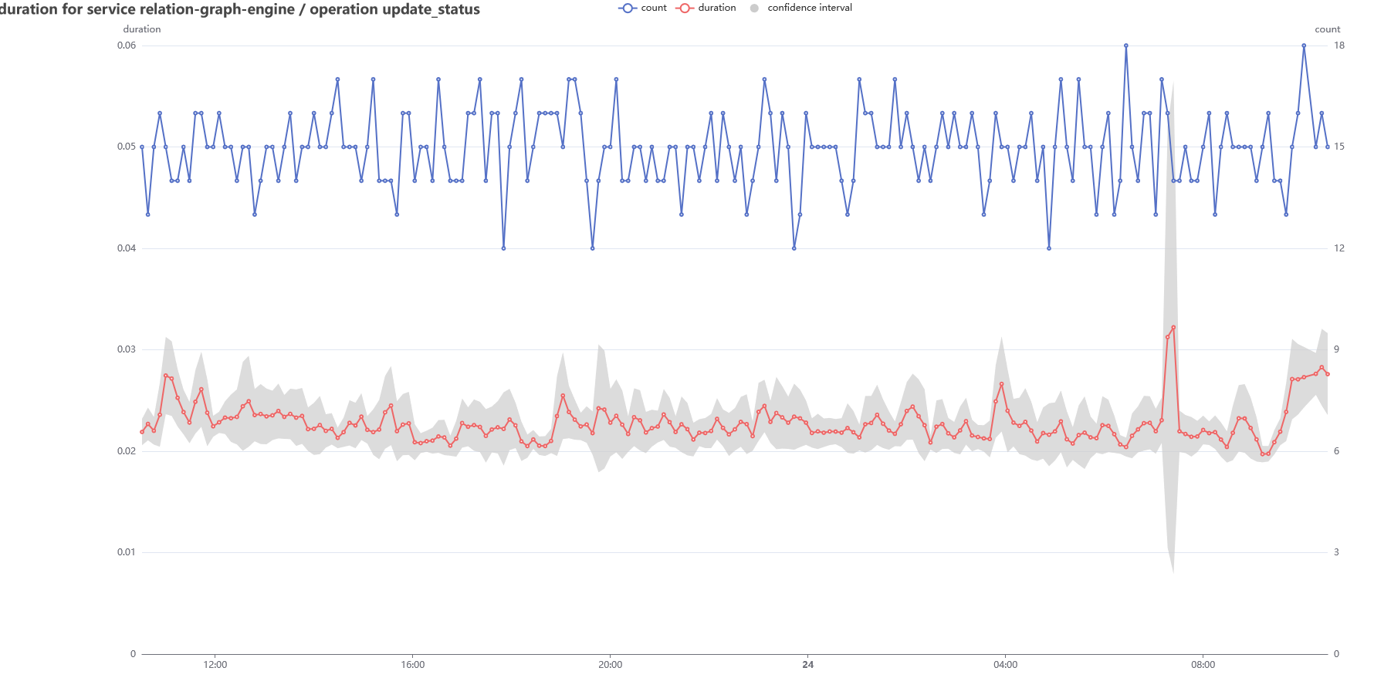
Graphs: duration

Slide 41
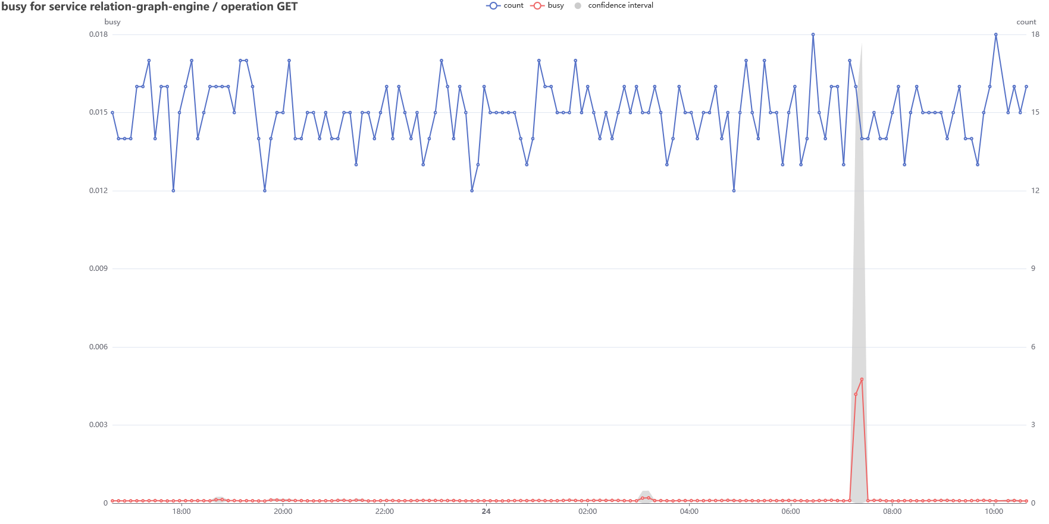
Graphs: busy

Slide 42
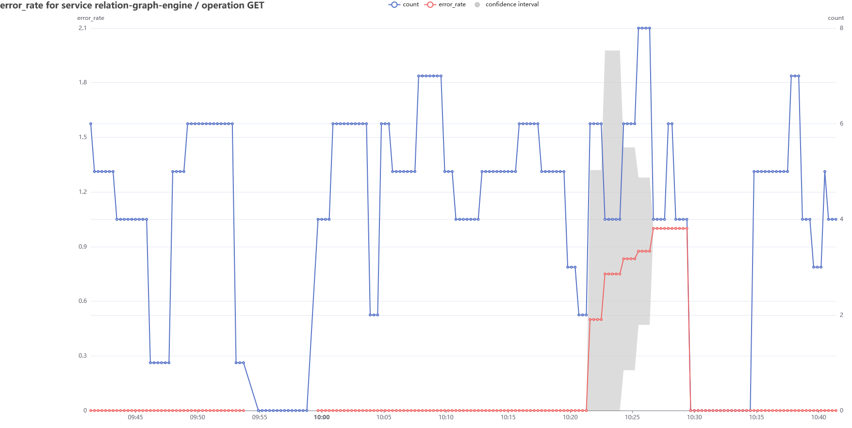
Graph: error_rate (simulated)

Slide 43
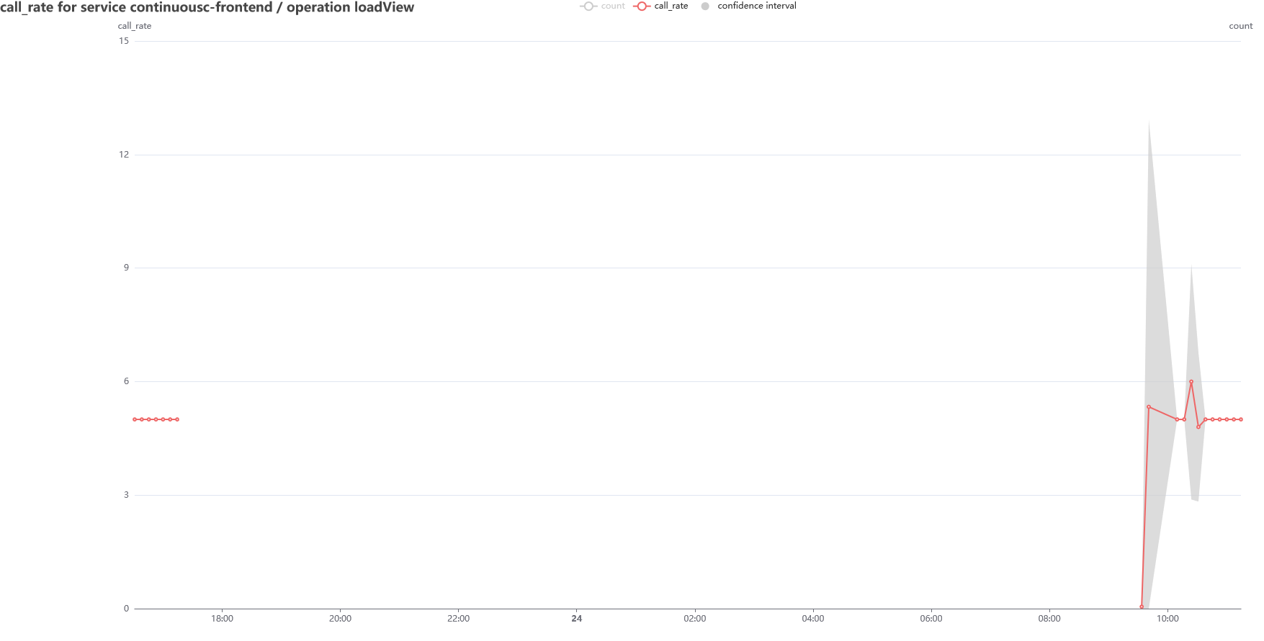
Graph: call_rate

Slide 44
Alert rules: fixed limit
Expression: param of metric over interval > threshold, for duration
Parameters:
Metric: duration, busy, error_rate, call_rate
Parameter:
Mean
Mean +/- n * stddev
Lower bound of confidence interval
Higher bound of confidence interval
Interval duration
Confidence interval certainty level: default 0.99
Threshold
Duration

Slide 45
Alert rules: compare short to long term
Expression: lower bound of confidence interval over short-term / ( offset + mean over long-term ) > threshold, for duration
Parameters:
Metric: duration, busy, error_rate, call_rate
Short-term param:
Lower bound of confidence interval (default)
Mean
Short-term duration: default 15m
Long-term param:
Mean (default)
Upper bound of confidence interval
Long-term duration: default 7d
Confidence interval certainty level: default 0.99
Threshold: default 1.5
Offset: depends on metric
Duration: default 15m

Slide 46
Alert rules: defaults
Duration / busy: lower bound of confidence interval over 15m / mean over 7d > 1.5, for 15m
Error rate: mean error rate over 5m > 25%, for 15m
Call rate: mean over 15m / (100 + mean over 7d) > 10

